Slide 1
Adverse Childhood Experiences (ACE’s) Lisa Delaney (Specialist Health Visitor – Public Health Early Years Support)

Slide 2
Definition:
Stressful events occurring during childhood that directly affect a child (e.g. child maltreatment), or affect the environment in which they live(e.g. domestic abuse within the home).
Bellis et al 2014

Slide 3
ACEs describe a wide range of stressful or traumatic experiences that may occur as the child is growing up;
Domestic Abuse
Drugs and /or alcohol abuse
Familial mental health issues
Loss due to bereavement
Incarceration of a family member
Loss due to separation or divorce of parents
Physical abuse
Emotional abuse
Sexual abuse
Neglect

Slide 4
“……….What is done to children they will do to society…………..” Dr Karl Menninger £ 15 million yearly average cost

Slide 5
For every 100 adults in the UK:
48 have experienced x1 ACE
9 have experienced 4 or more ACEs

Slide 6
ACEs increase an individuals’ risk of developing health-harming behaviours
Compared with people with no ACEs, those with 4+ACEs are:
2x more likely to currently binge drink and have a poor diet
3x more likely to be a current smoker
5x more likely to have had sex whilst under aged 16 yrs
6x more likely to have had or caused an unplanned teenage pregnancy
7x more likely to have been involved in violence in the last year
11x more likely to have used heroin/crack or been incarcerated

Slide 7
4 or more ACEs
2.5x increased risk of acquiring a sexually transmitted infection
5x increased risk of illicit drug use
7x increased risk of alcohol addiction
12x increased risk of attempted suicide
2.5x increased risk of COPD
2.5x increased risk of Hep B
4x risk of depression
6 or more ACEs
46x increased risk of IV drug use
35x increased risk of suicide
At risk of their lifespan being shortened by 20 years
7 or more ACEs
X3 risk of lung cancer
X3.5 risk of ischaemic heart disease

Slide 8
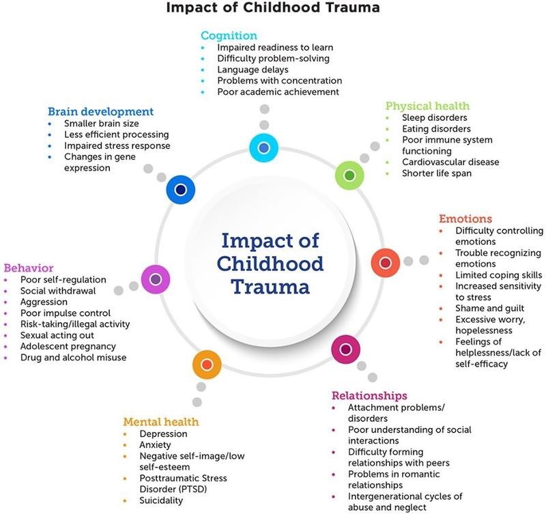

Slide 9
The previous slide is very busy.
The important information to take away is that experiencing trauma in childhood (ACE’s) affects every system of the body and every aspect of a child life.
These affects are life long and potentially life shortening.
It highlights the need to ensure information about a child's early experiences is communicated to new professionals as a child transitions through agencies (ie health to nursery to school to extra curricular activities)

Slide 10
It needs to be remembered that not every child who experiences ACE’s will be adversely affected.
…………………It is not a done deal ……………
Thorough assessments and recording of information for individual children and families may lead to a greater understanding of why some children appear to have more resilience than others. In turn this can help shape future service delivery.

Slide 11
Preventing ACEs in future generations could reduce levels of:
Early sex by 33%
Unintended teen pregnancy by 38%
Smoking by 16%
Binge drinking by 15%
Cannabis use by 33%
Heroin/crack use by 59%
Violence victimisation by 51%
Violence perpetration by 52 %
Incarceration by 53%
Poor diet by 14%

Slide 12
Next Steps
Within Calderdale Health Visiting (PHEYS) and School Nursing services we are looking at how we assess and record this information for each individual child/young person.
In order to support individuals and improve outcomes ,it is hoped that this work will continuously evolve, forming the foundation blocks for partnership working looking at:
a)existing services we can utilise
b) gaps in service that need to be developed

Slide 13
What can you do ?
Start having conversation with colleagues
Look within your own organisation at how this information may be recorded and shared
Look for opportunities to really make a difference through partnership working
Look for those cases where expectations have been surpassed, these may provide valuable information into individual resilience and future service development

Slide 14
“……………..Adverse Childhood experiences are the single greatest unaddressed public health threat facing our country……………” Dr Robert Block

Slide 15
References:
https://www.youtube.com/watch?v=W-8jTTIsJ7Q
https://youtu.be/XHgLYI9KZ-A
https://www.youtube.com/watch?v=95ovIJ3dsNk
Collingwood S, Knox A, Fowler H, Harding S, Irwin S, and QuinneyS. The Little Book of Adverse Childhood Experiences. Imagination Lancaster, University of Lancaster 2018
Bellis MA, Hughes K, Leckenby N, Perkins C, Lowey H. National household survey of adverse childhood experiences and their relationship to health harming behaviours in England. BMC Medicine 2014, 12:72 https://academic.oup.com/jpubhealth/article/36/1/81/1571104
Felitti, V. J., Anda, R. F., Nordenberg, D., Williamson, D. F., Spitz, A. M., Edwards, V., et al. (1998). Relationship of childhood abuse and household dysfunction to many of the leading causes of death in adults: The Adverse Childhood Experiences (ACE) Study. American journal of preventive medicine, 14(4), 245-258
https://www.70-30.org.uk/

