Slide 1
Domestic Abuse
This 7 minute briefing covers:
The increased risk around domestic abuse during the Covid-19 outbreak
Definition and types of domestic abuse
Who is affected by domestic abuse
Coercive control and stalking
Signs and symptoms
Good practice
Responding, signposting and support

Slide 2
Increased risk – Covid 19
Whilst the nation is being instructed to comply with social distancing and self-isolation, it is important to recognise that these understandable measures may mean that the risk of harm (both in frequency and severity) for those experiencing, or at risk of experiencing domestic abuse may actually increase
Domestic abuse has always been a ‘hidden’ crime that takes place behind closed doors
Adults at risk and children do not get the level of support they need
Risks are expected to continue to increase significantly
There is increased risk to children where domestic abuse is in the home due to increased stress and tension

Slide 3
WHY?
Self-isolation, more home working and additional childcare responsibilities have the potential to make those at risk more invisible with less chance to seek help/disclose if abuse is happening.
Home for many families is not a place of safety, but a place where they will face a potential increase in violence and psychological abuse as well as even greater isolation
Most children will not be attending school so there is less opportunity for staff and partners to pick up on issues
The mental health of both victims and perpetrators could be significantly and adversely affected
Lack of social and sporting events may increase frustrations within the home
Worries about finance and day to day living are likely to become more evident which could increase risk
Increased issues over child contact

Slide 4
What can I do?
Complete this briefing so that you are familiar with the types of domestic abuse and know how to signpost/refer someone into specialist support services
Keep communication channels open with vulnerable people and households
Speak (remotely) to your friend, neighbours, colleagues, staff and teams so that we can be the ‘eyes and ears’ within our communities. Even more so, during this period

Slide 5
Definition
‘Any incident or pattern of incidents of controlling, coercive or threatening behaviour, violence or abuse between those aged 16 or over who are or have been intimate partners or family members regardless of gender or sexuality.’
The Home Office (as of 2013)

Slide 6
What this means in reality:
Coercive and controlling behaviour – see later slide
Psychological and emotional abuse - Shouting, name calling, blaming and shaming, isolation, intimidation, threats of violence (to the person and/or family members/pets
Physical abuse - Pushing or hair pulling, punching or slapping, biting, kicking, burning, broken bones, use of weapons, strangulation and choking
Sexual abuse - Disclosure of rape, making the victim perform degrading sexual acts, sulking or punishing someone for not having sex.
Economic abuse Rigidly controlling a victim’s access to resources and money
Honour based abuse - where people are punished for undermining a code of behaviour in their family community as well as female genital mutilation (FGM) and forced marriage

Slide 7
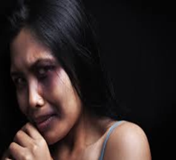
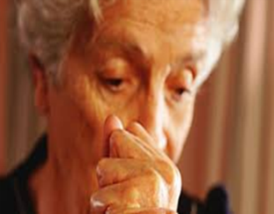
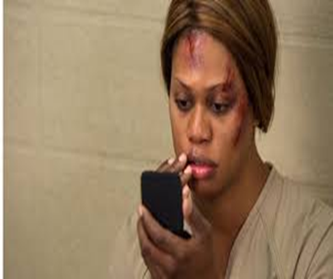
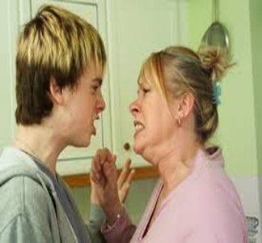
Who?
Domestic abuse can affect anyone, although women are disproportionately affected (and research suggests that they are more likely to suffer more serious injury and ongoing assaults than men). Other more ‘hidden victims’……..

Slide 8
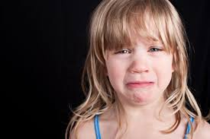
Children
Domestic violence can impact on children immensely. Statistics show that:
62% of children exposed to domestic abuse were directly harmed (physical/emotional abuse & neglect)
52% had behavioural problems
39% had difficulties at school
60% felt they were to blame
25% exhibited abusive behaviour towards victim and siblings

Slide 9
Coercive Control
This is controlling behaviour and is part of the psychological violence that is almost always present in relationships where domestic abuse is a feature.
It is:
Isolating a person from their friends and family
Controlling what they do, where they go, who they can see, what they wear and when they sleep
Repeatedly putting them down, such as telling them they are worthless
Enforcing rules and activity which humiliate, degrade or dehumanise the victim
Financial abuse
Threats to reveal or publish private information – controlling social media
Victims may feel intense anxiety, depression, isolation, a lack of perspective on reality, distorted perception of acceptable behaviour, fear, low confidence and self-esteem and a wide range of physical and mental health problems.

Slide 10
Stalking
Pattern of fixated and obsessive behaviour
Repeated, persistent, intrusive
Causes fear of violence and/or causes alarm and distress
Sending gifts, making unwanted or malicious communication; damaging property, physical and sexual assault
Stalking and coercive control are often correlated and can be a high risk indicator of harm

Slide 11
Signs & symptoms
Injuries and excuses
Low self esteem and personality changes
Fear of conflict
Self blame
Isolation and control
Stress related problems
Property damage
Appointments: missed, frequently rescheduled, partner accompanies
Mental distress
Partner’s behaviour: aggressive, overly dominant, doesn’t let partner speak for themselves

Slide 12
Good practice
Don’t be scared to ask questions and be curious if it is safe to do so. This is important because:
it can show the person you care and want to support them
the person you’re talking to may not appear to be a ‘typical’ victim
it allows opportunity for disclosure
it helps to build up a bigger picture of what’s happening so you can think about risk; their sense of danger and how safe they feel

Slide 13
However, if you are carrying out a telephone consultation you must consider that the perpetrator may be in the same room (or able to overhear) and/or the children might be present Always ask: ‘Is it ok for you to talk?’
If the response is: ‘No’ – accept this and tell the person you will ring back or they can ring you when it is more convenient. Record that this has happened and follow up with your line manager and/or safeguarding team if needed ‘Yes’ - See useful prompts/questions on the next slide but remain mindful that the person may quickly hang up or sound different if the situation changes. If you suspect the person is in the room, it can be safer to ask questions/end the call by only asking questions that require a yes/no answer

Slide 14
ASK…
Does your partner ever frighten you?
Do you spend a lot of time trying to keep your partner happy?
What happens when your partner is angry?
Has someone else ever frightened or hurt you or your children?
Do you ever have sex with your partner even if you don’t feel like it?
Has anyone ever hurt you? Who?
Does your partner make it difficult for you to come to attend work or other appointments?
How do you cope with your partner’s anger?
Where do you go when you are frightened?
Is there anyone you can talk to when you are frightened or upset?

Slide 15
Safeguarding Team
Please seek advice from CHFT safeguarding team and/or follow existing procedures in relation to responding to and referring to Domestic abuse
01422 224570 (CRH x4570)
chft.safeguarding@nhs.net or domestic.abuse@nhs.net

Slide 16
EMERGENCY RESPONSE
WEST YORKHIRE POLICE
Call 999 if immediate or substantial risk; danger to life (101 for anything else)
CONCERNS ABOUT A CHILD
Kirklees Children’s Services: call 01484 456848 (Mon-Fri 9am – 5pm).
Out of hours call: 01484 414933 (Emergency Duty Team)
Calderdale MAST: 01422 393336, (Mon-Fri 9am – 5pm) Out of hours call: 01422 288000 (Emergency Duty Team)
CONCERNS FOR A VULNERABLE ADULT
Kirklees Gateway to Care: call 01484 414933
Calderdale Gateway to Care: call 01422 393000
(these numbers also diverts to Emergency Duty outside office hours)

Slide 17
Signposting & support available
Pennine Domestic Abuse Partnership (Kirklees residents)
0800 0527222 (24 hour helpline)
Staying Safe (Calderdale Residents)
01422 323339 – Dedicated Health IDVA role 07590884206
Women Centre (Kirklees and Calderdale)
01484 450866
Freephone National Domestic Abuse Helpline, run by Refuge 0808 200 0247 www.nationaldahelpline.org.uk
Galop (for lesbian, gay, bisexual and transgender people) 0800 999 5428 www.galop.org.uk
Men’s Advice Line 0808 801 0327 www.mensadviceline.org.uk
Rape Crisis (England and Wales) 0808 802 9999 www.rapecrisis.org.uk

